Slide 1
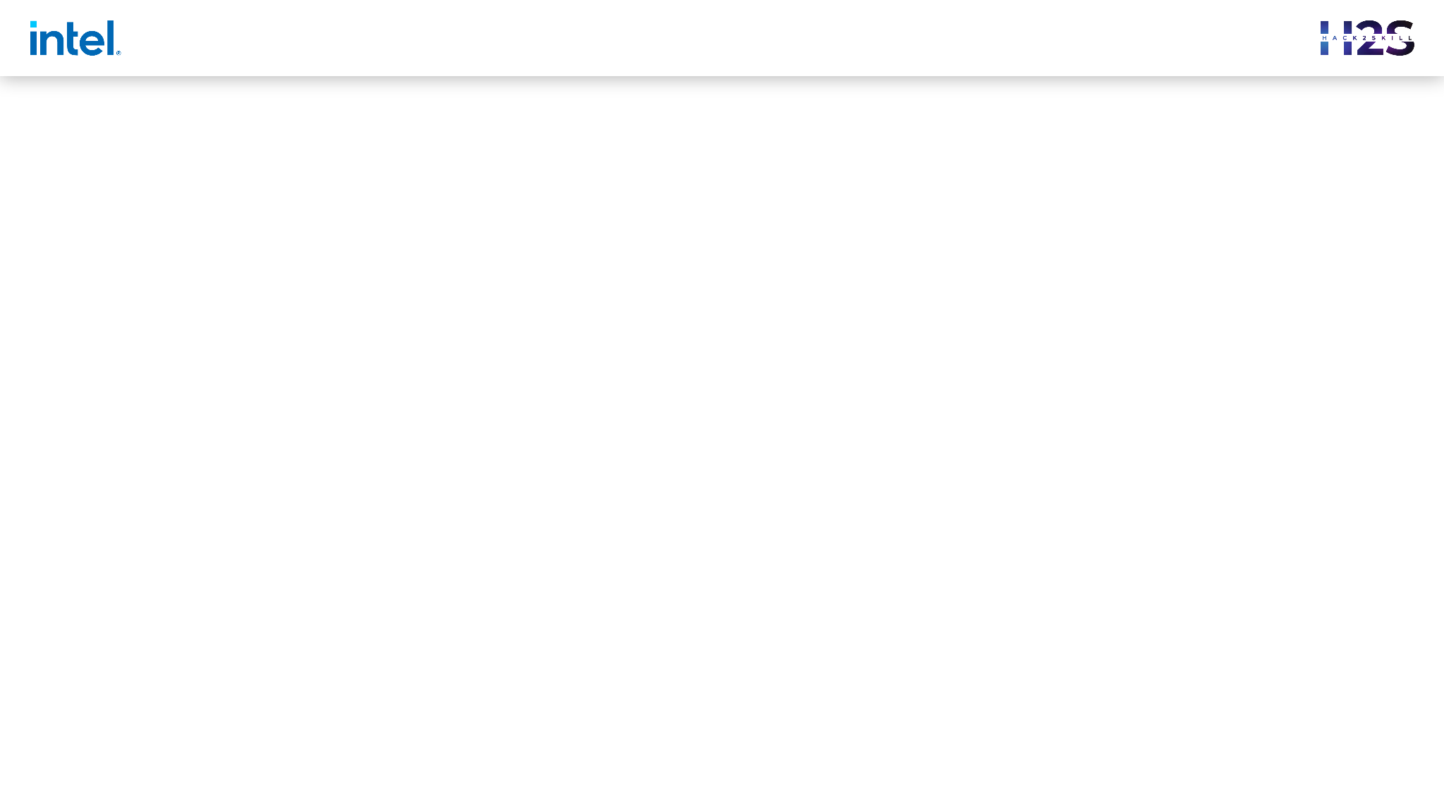

Guidelines
Feel free to use any other template of your choice, given it covers all the mentioned points of the sample template
The ideal size of the presentation should not be more than 10 slides.
At this stage the evaluation will only be made on the basis of the prototype.
In case of queries drop in a mail at support@hack2skill.com

Slide 2
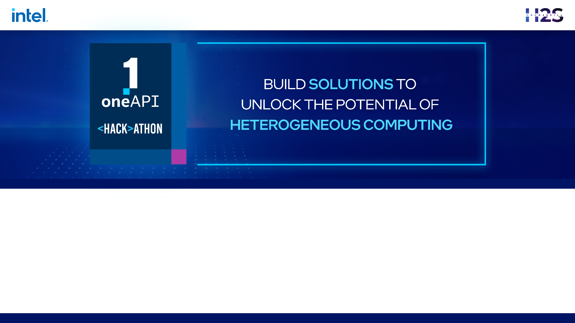
oneAPI_ODAV - oneAPI
Team Name : Hitaya
Team Members : Jayita Bhattacharyya, Arnab Das, Sayan Sinha, Subhasish Dutta

Slide 3
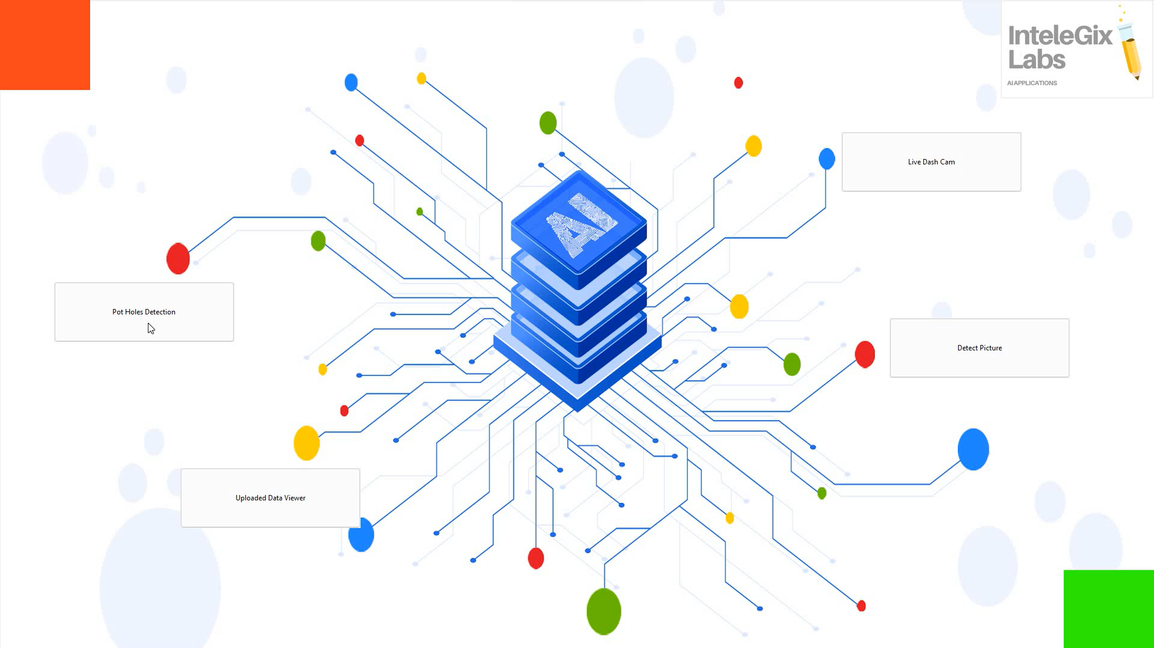
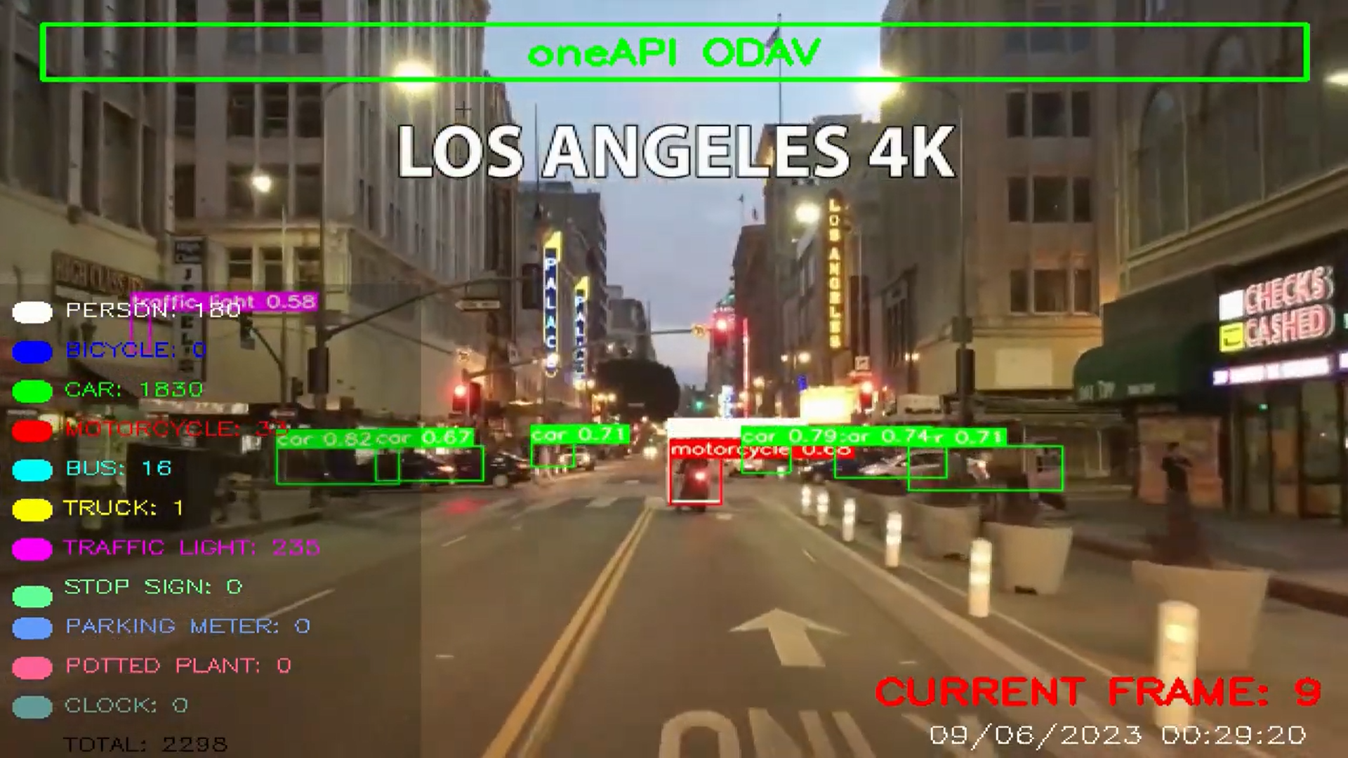
Problem Statement - Object Detection For Autonomous Vehicles
A real-time object detection model for autonomous vehicles using computer vision techniques and Intel® AI Analytics Toolkits its libraries, and SYCL/DPC++ Libraries. To create a deep learning model that can accurately detect objects such as pedestrians, vehicles, traffic signs, and traffic signals. The model should perform with high accuracy and low latency, ensuring safe navigation for autonomous vehicles.

Slide 4
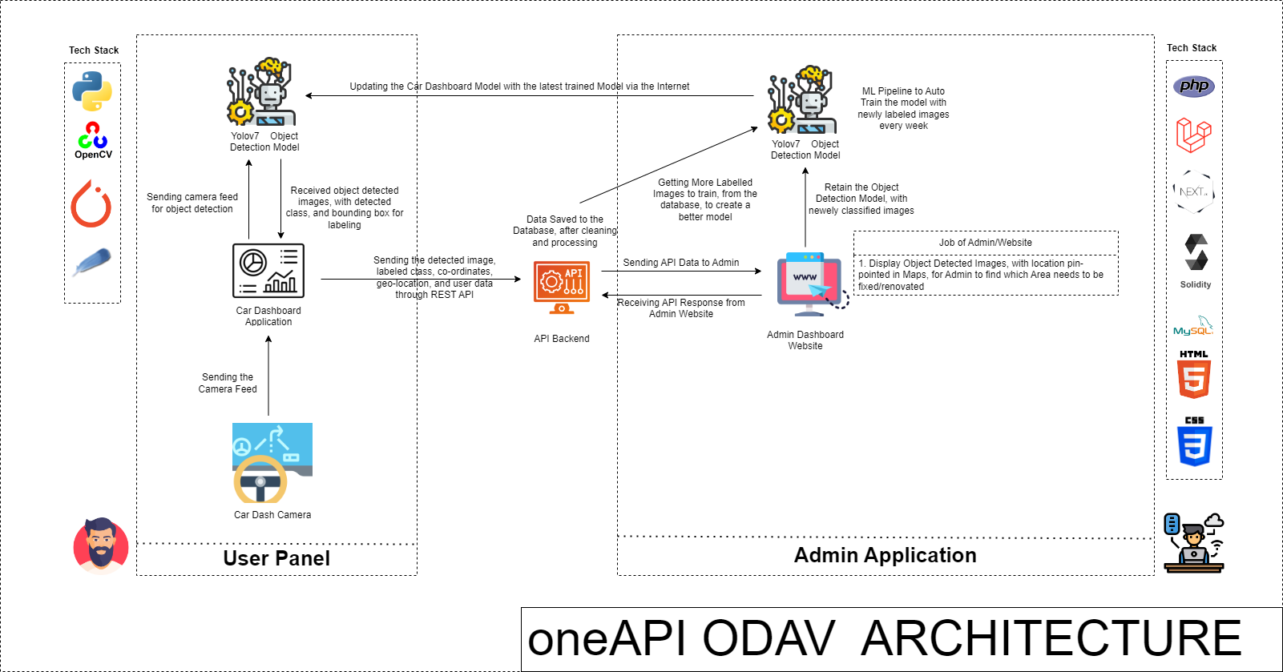
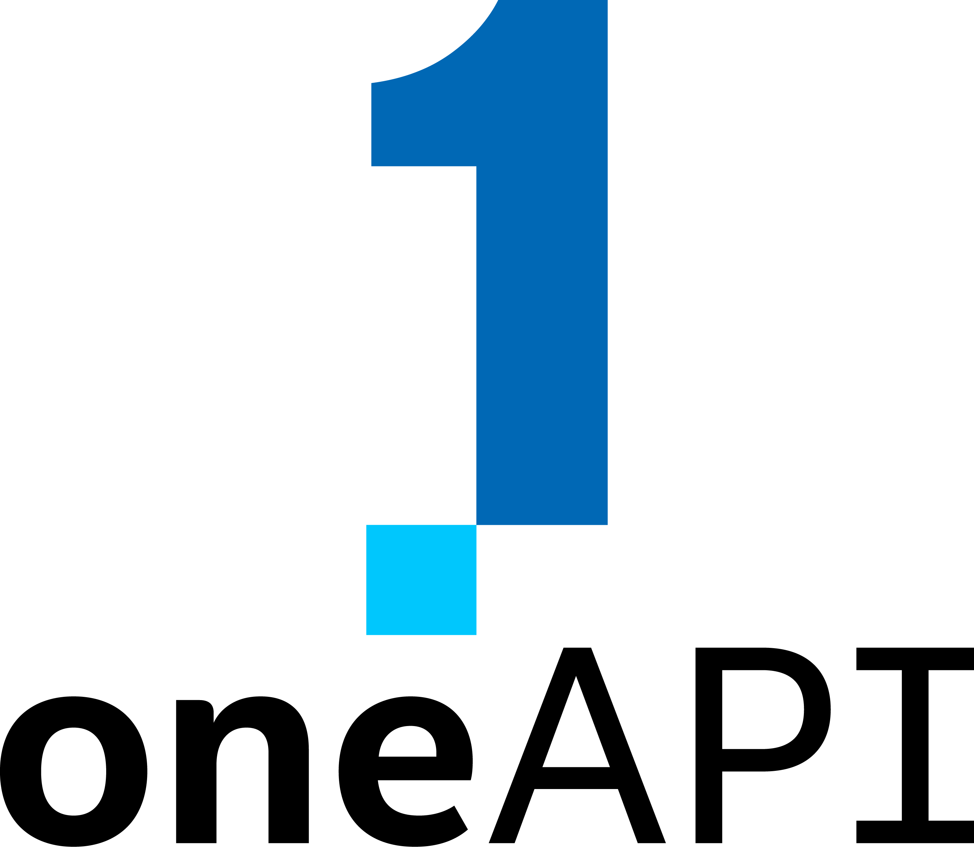
Architecture – Impact of oneAPI/SYCL (How oneAPI /SYCL helped you?)

Slide 5
Core components of oneAPI/SYCL used in the project
Intel® Optimization for PyTorch
Intel® Distribution for Python
Intel® Distribution of Modin (For Data Analysis)
How is helps us?
Model training and performance got significant boost after training it using Intel Dev cloud using Jupyter Notebook.
We can train on a huge dataset at the same time, by using Dev cloud.

Slide 6
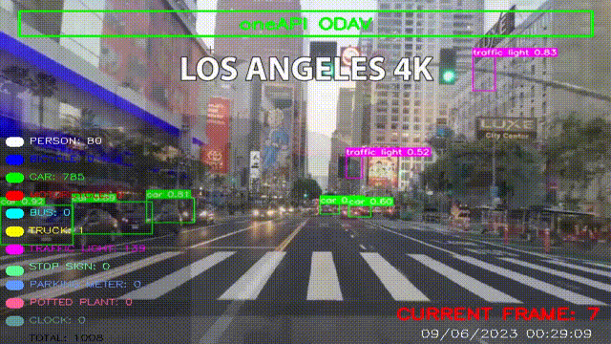
Demo Video/Live Demo
Please elaborate oneAPI/SYCL usage

Slide 7
GitHub Link (Codes should be public and available after hackathon also)
Codebase Link - https://github.com/jayita13/oneAPI_ODAV
Working Demo Video - https://www.youtube.com/watch?v=aCLAOy6iWAs

Slide 8
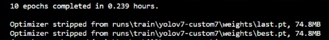
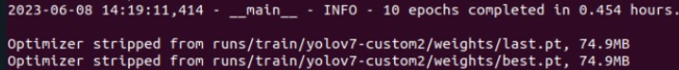
Results Summary (focus on unique aspects of oneAPI/SYCL that you have used)
With OneAPI Without OneAPI
Model gains almost 2x faster performance training optimized speed with IPEX (Intel Optimization for PyTorch)

Slide 9
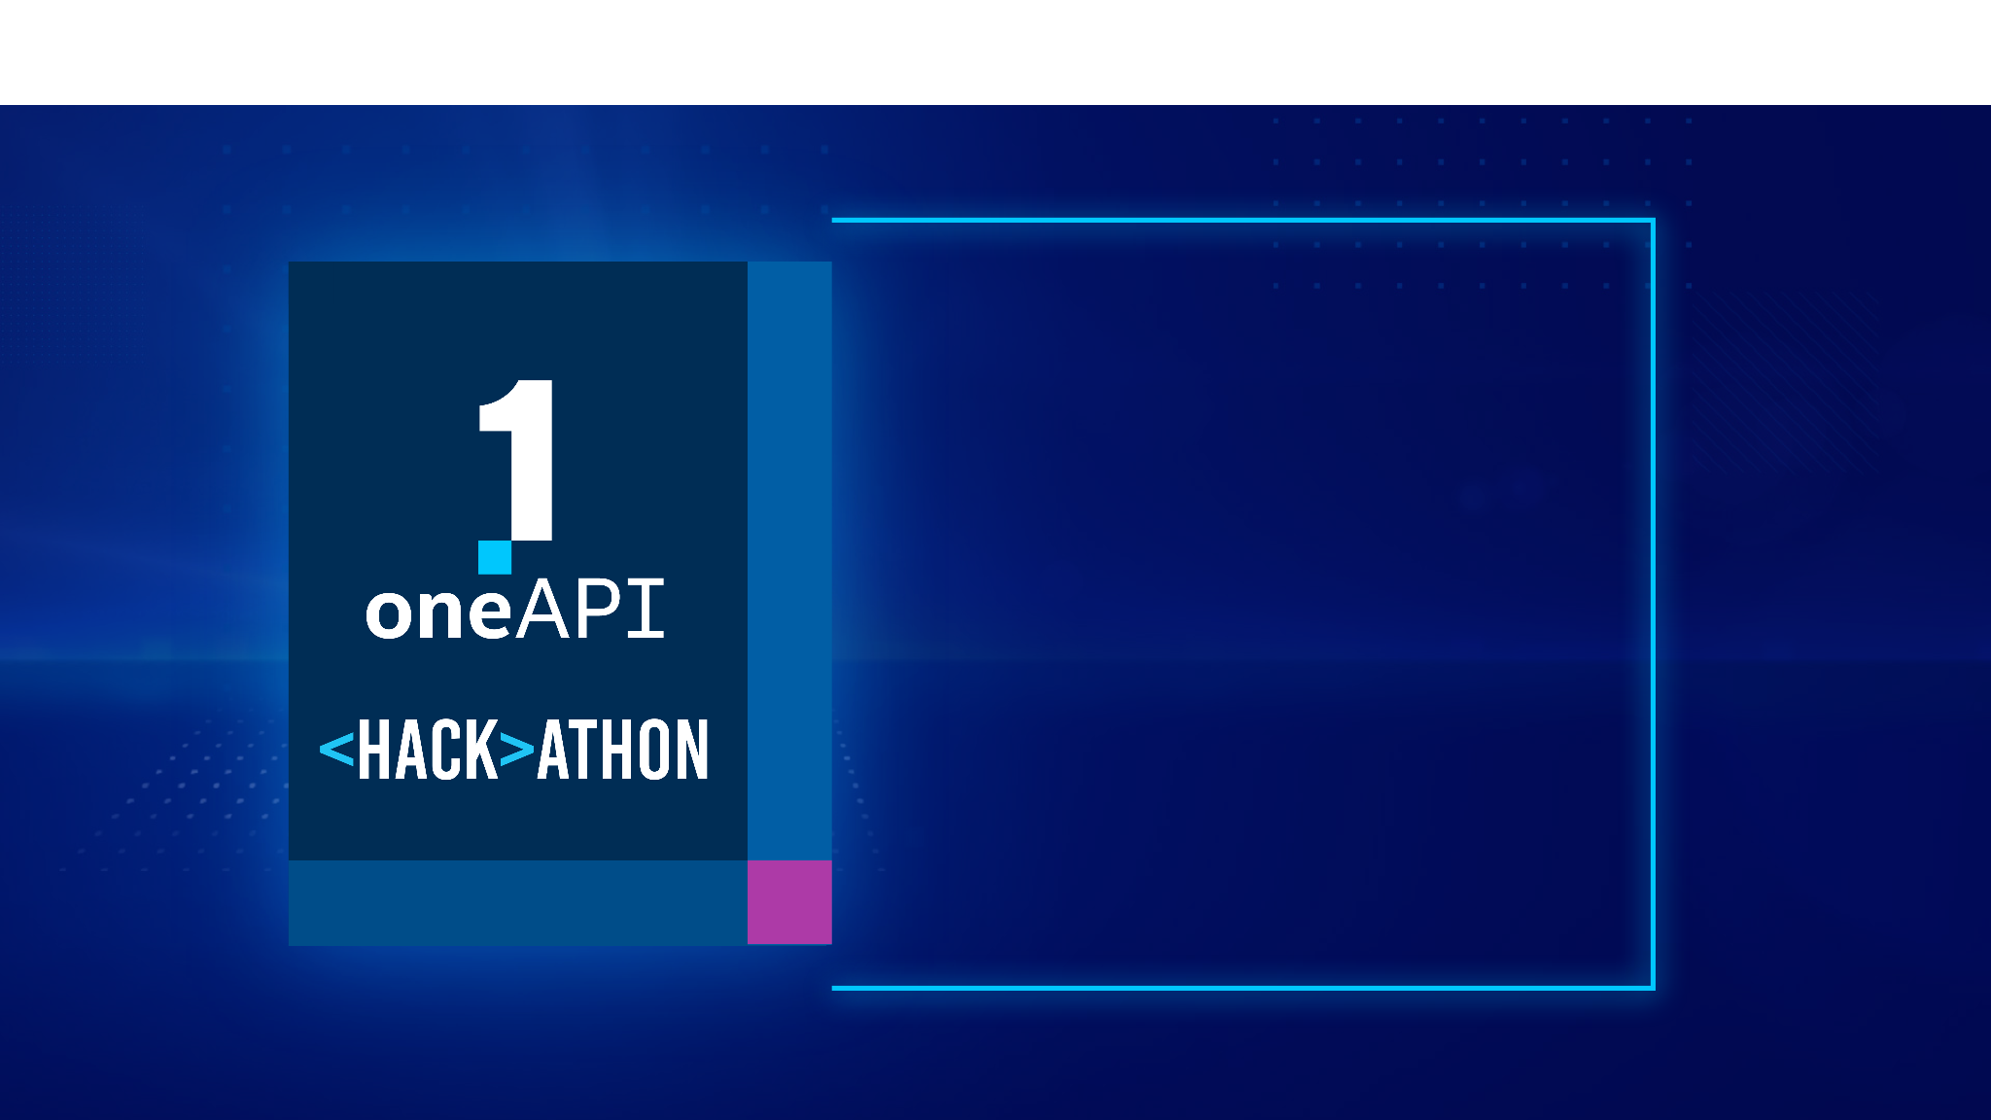
THANK YOU

